Slide 1
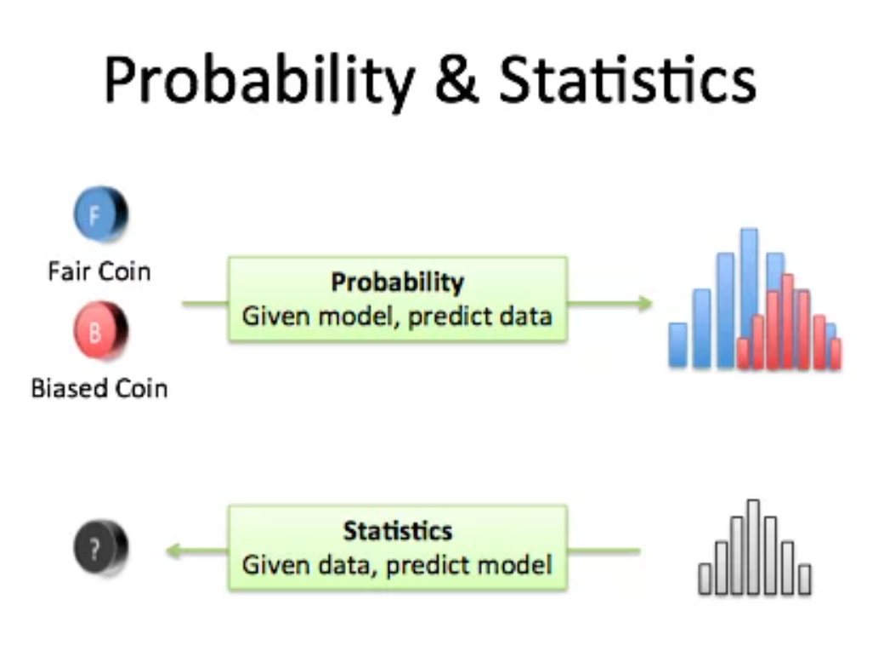
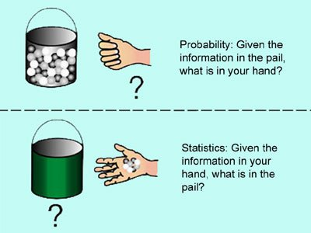
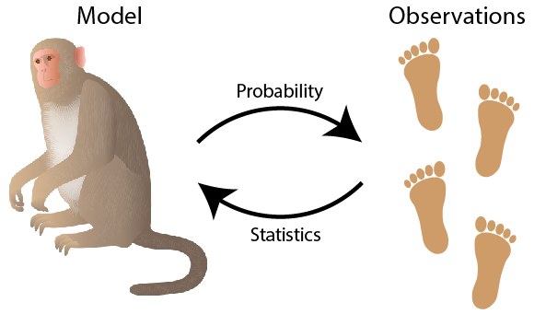
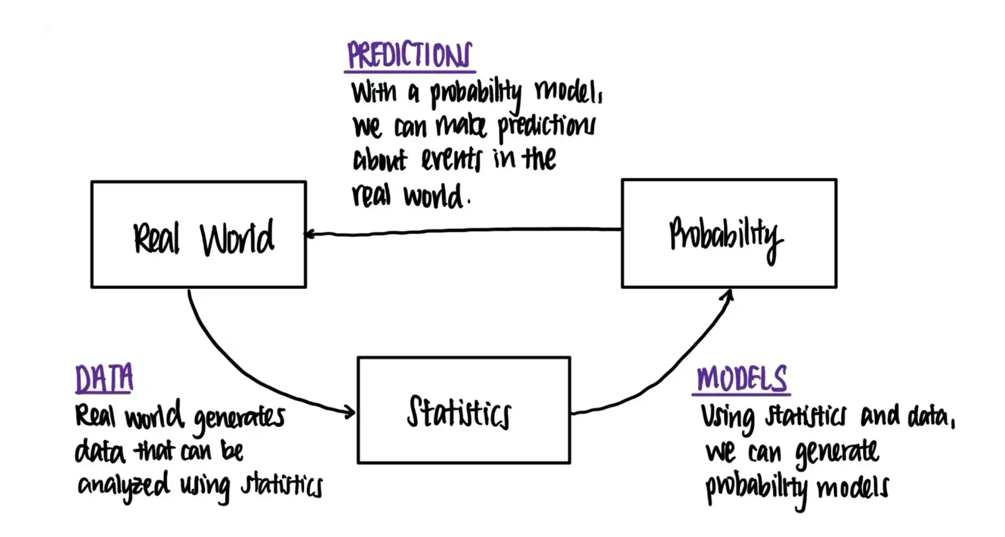
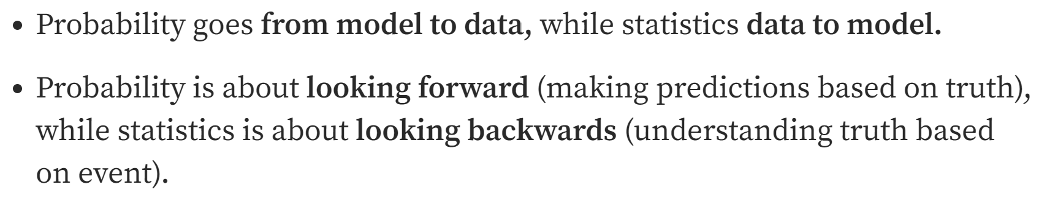
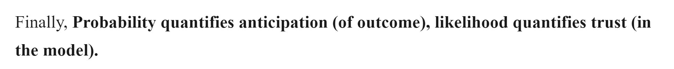

Slide 2
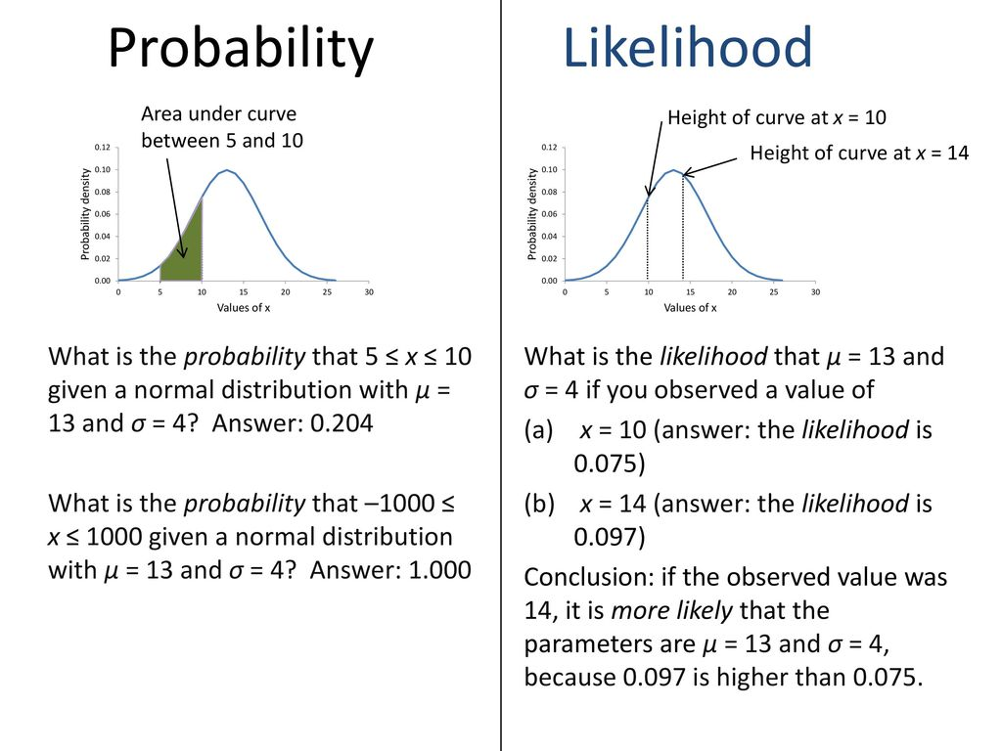

Slide 3
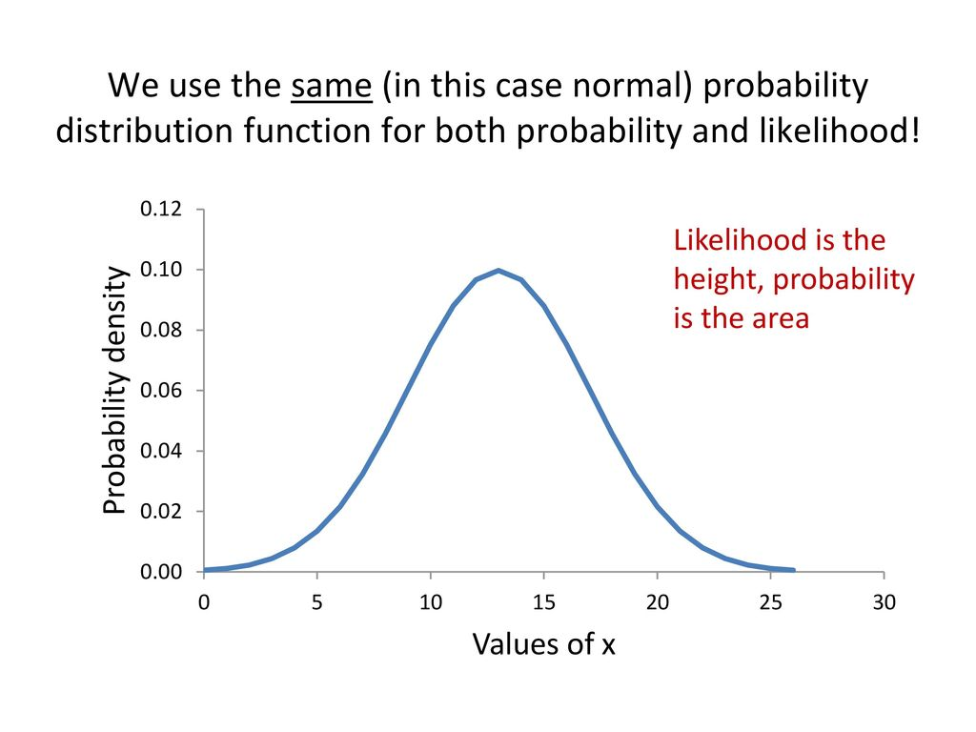

Slide 5
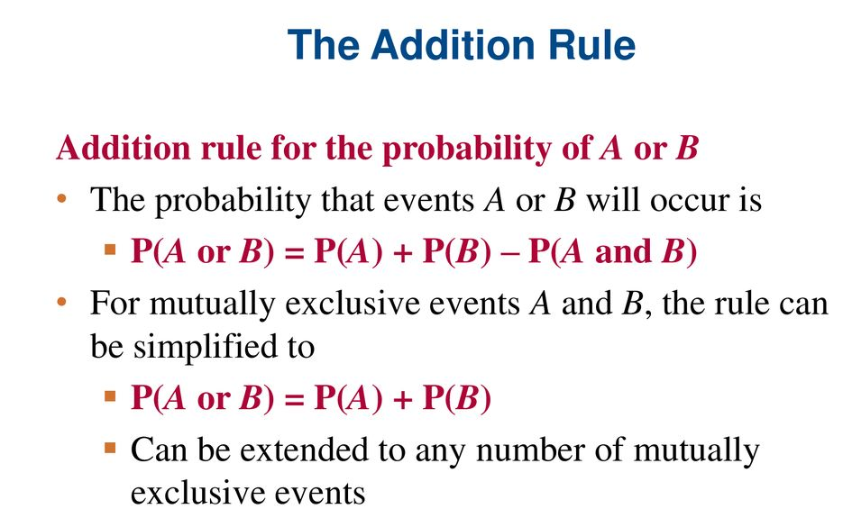
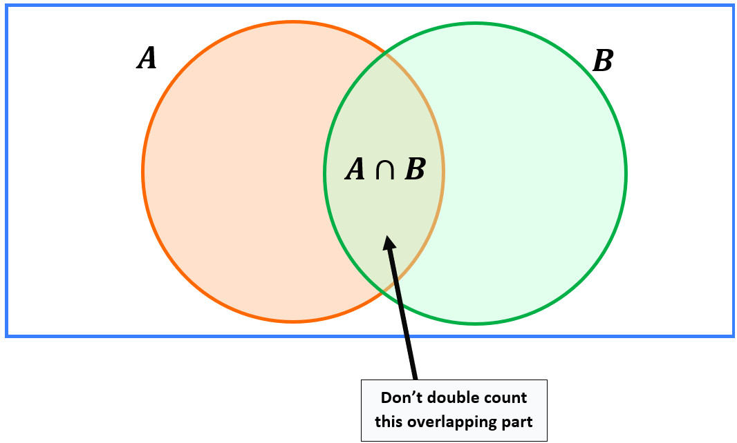

Slide 6
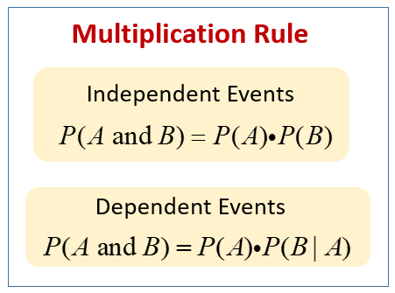

Slide 7
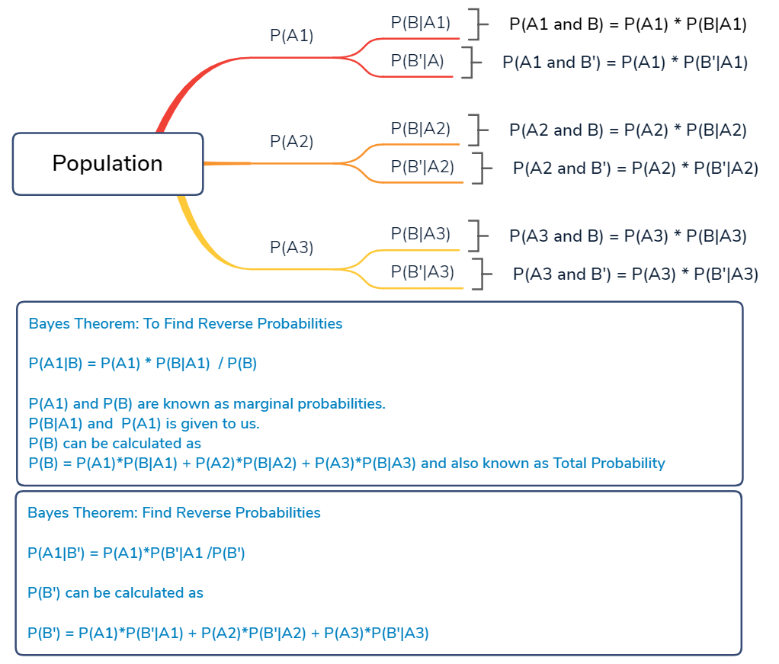
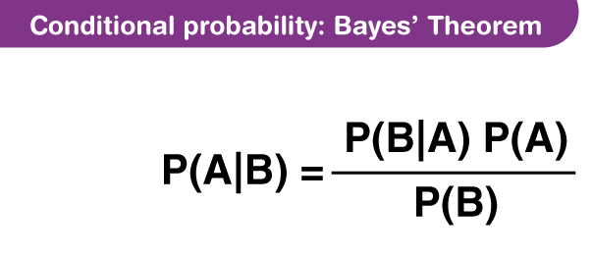

Slide 8
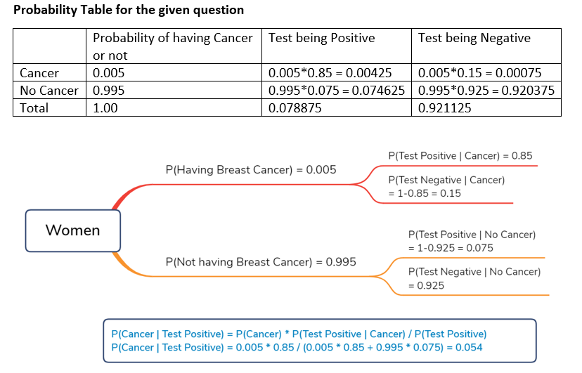

Slide 9
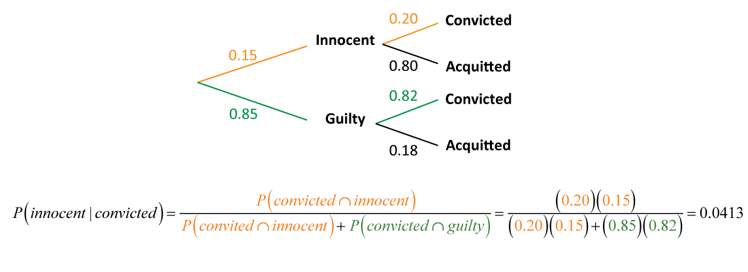

Slide 10
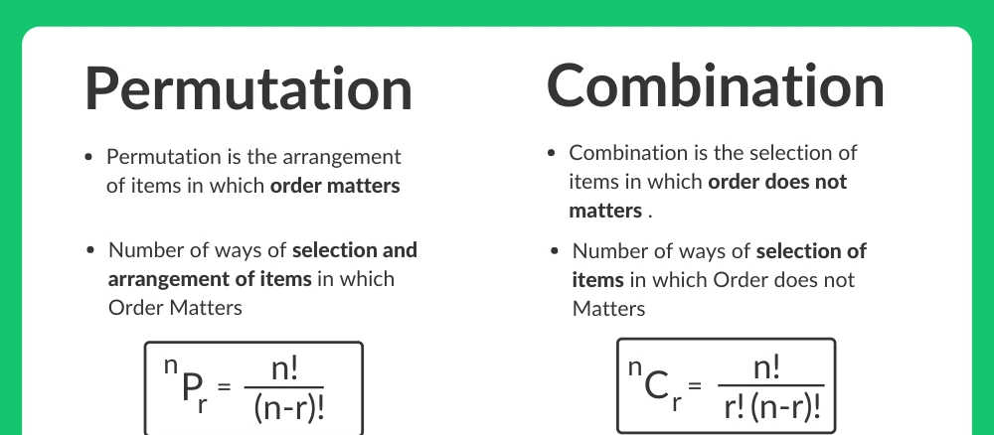
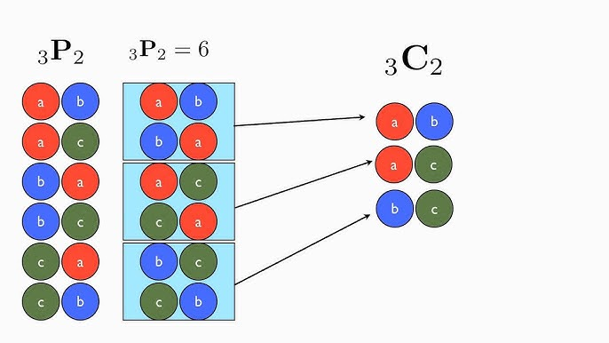

Slide 11
Problems

Slide 12
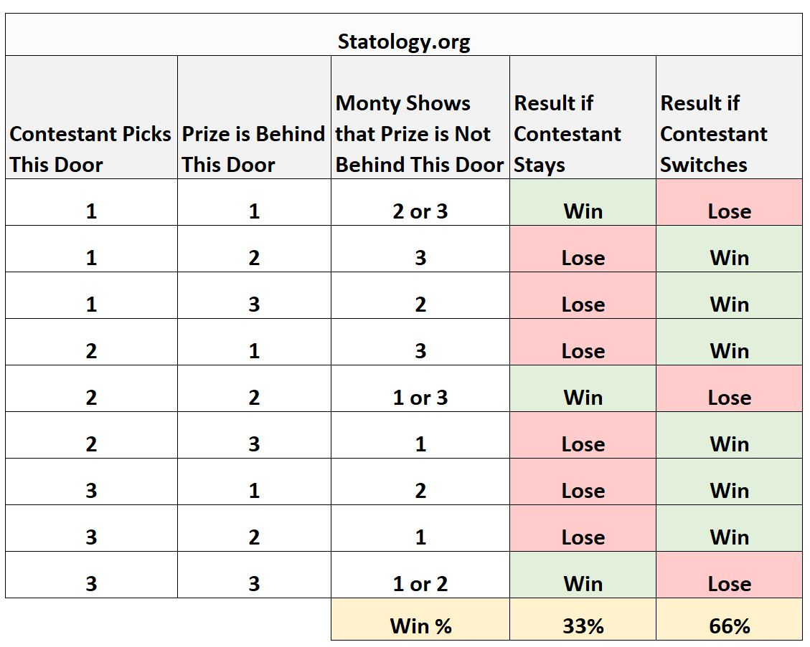
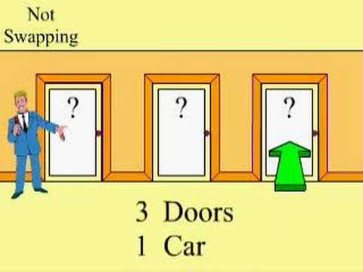
Monty Hall Problem

Slide 13
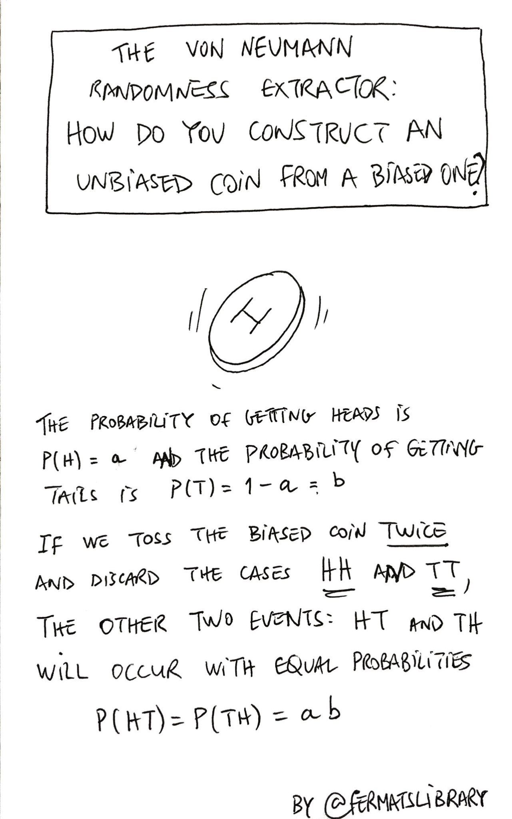
Simulating Fair coin flip from unfair coin

Slide 14
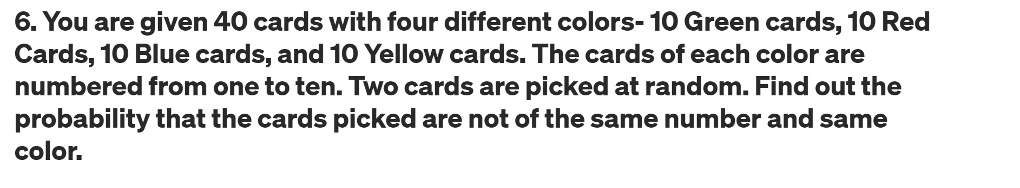
Let say first card we pick is Red 5
How many card left which are not red and not 5
27/39 = 0.69

Slide 15
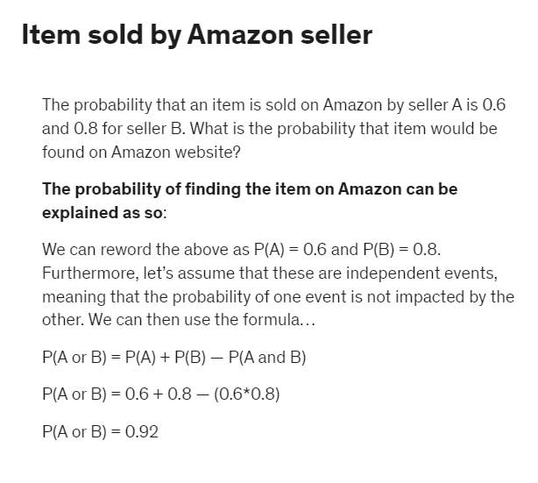

Slide 16
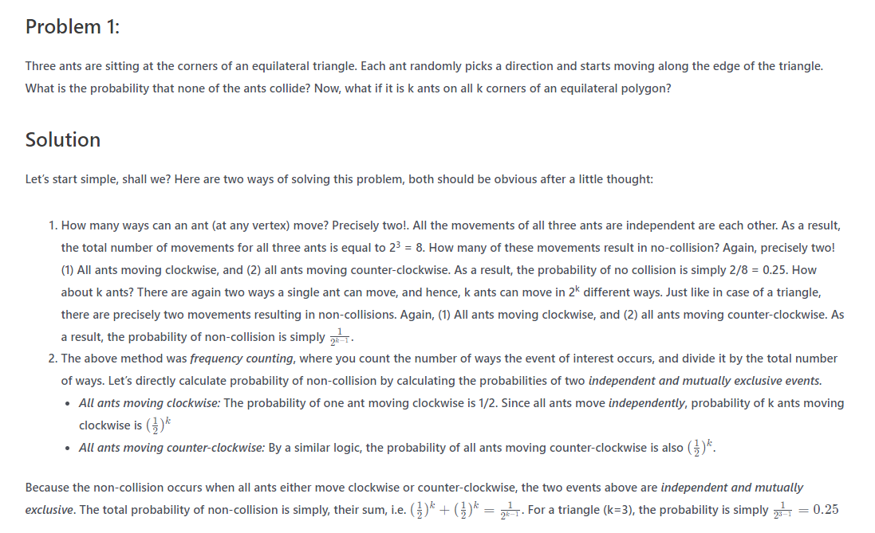

Slide 17
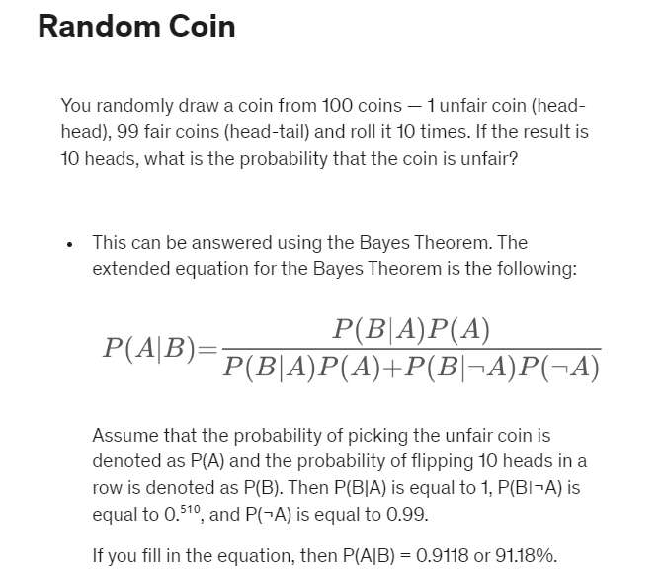

Slide 18
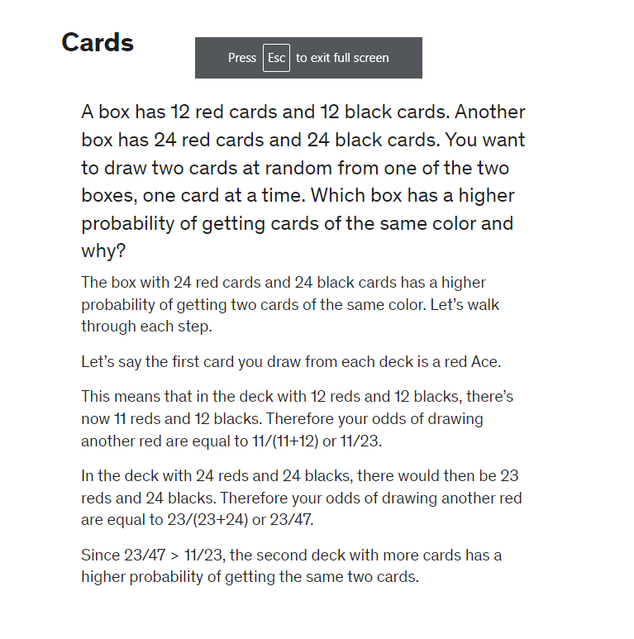

Slide 19
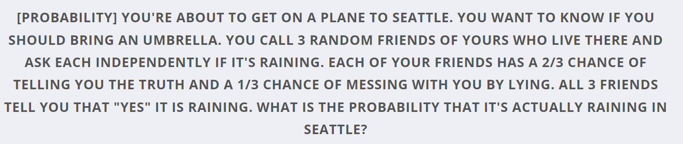
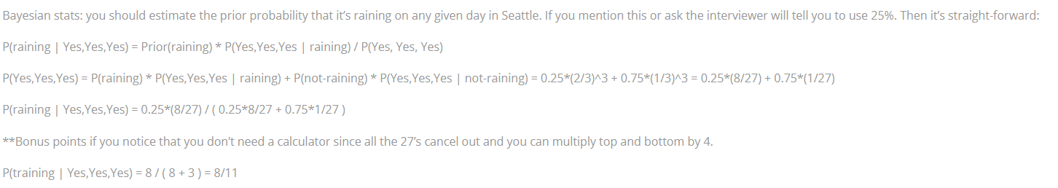

Slide 20
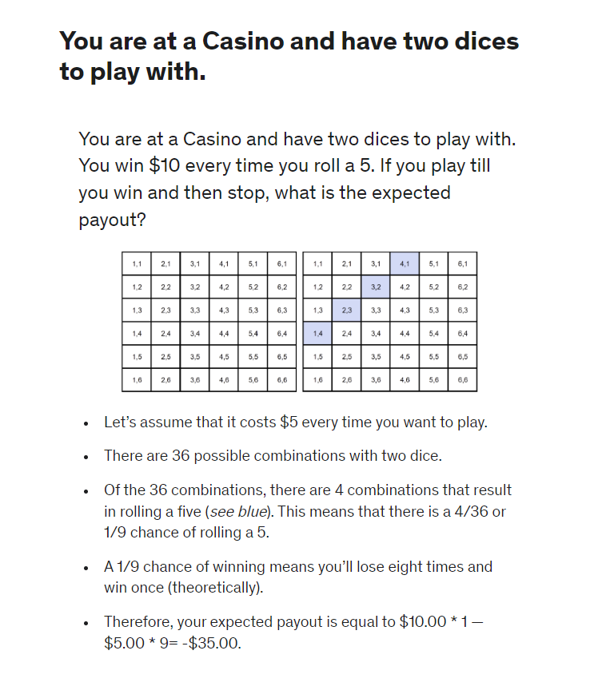

Slide 21
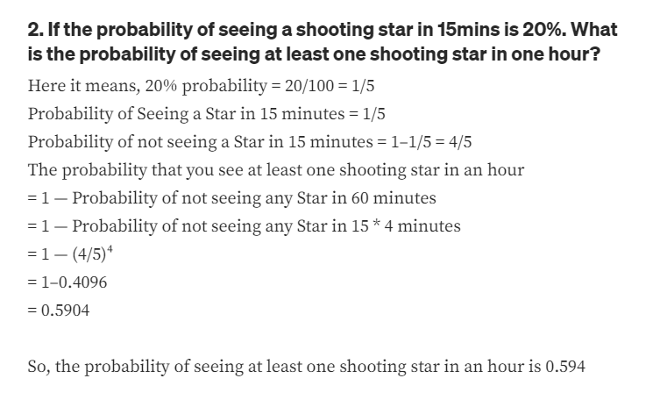

Slide 22
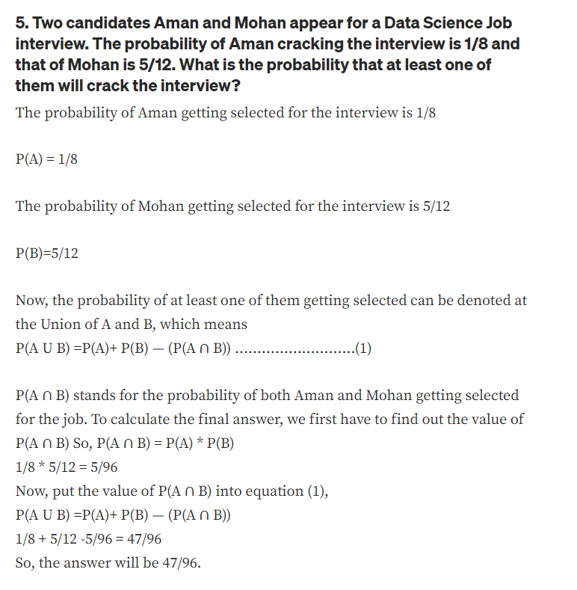

Slide 23
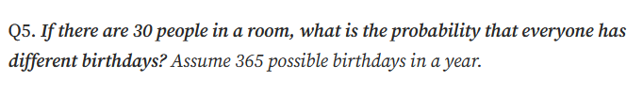
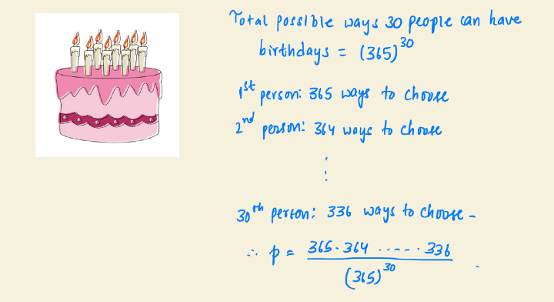

Slide 24
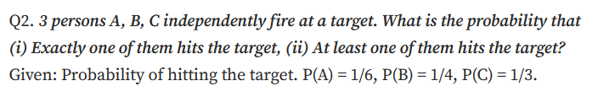
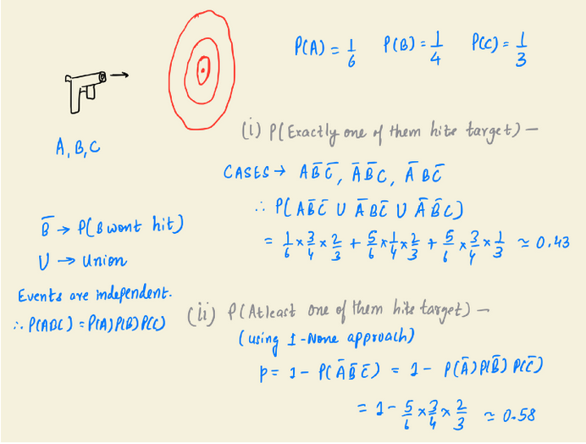

Slide 25

What is the probability of rolling two six-sided dice and obtaining at least one 3?

Slide 26
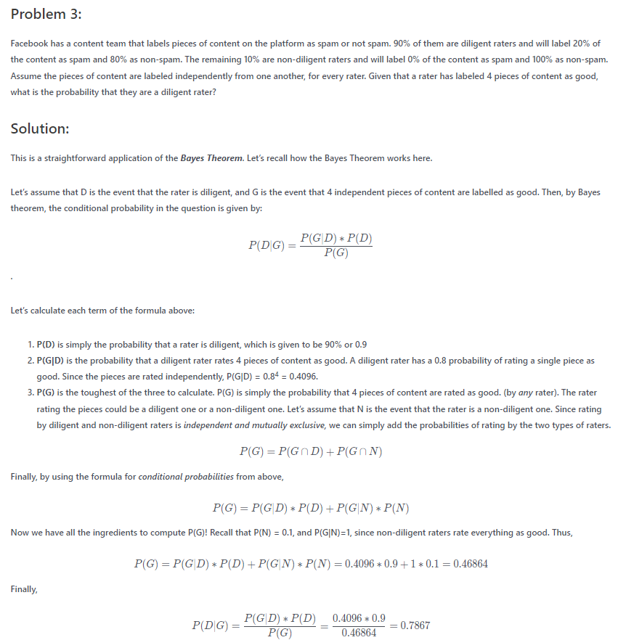

Slide 27
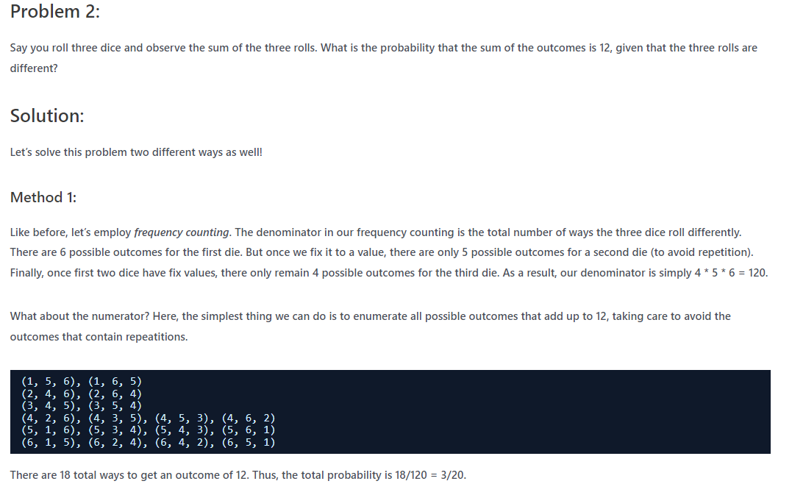

Slide 28
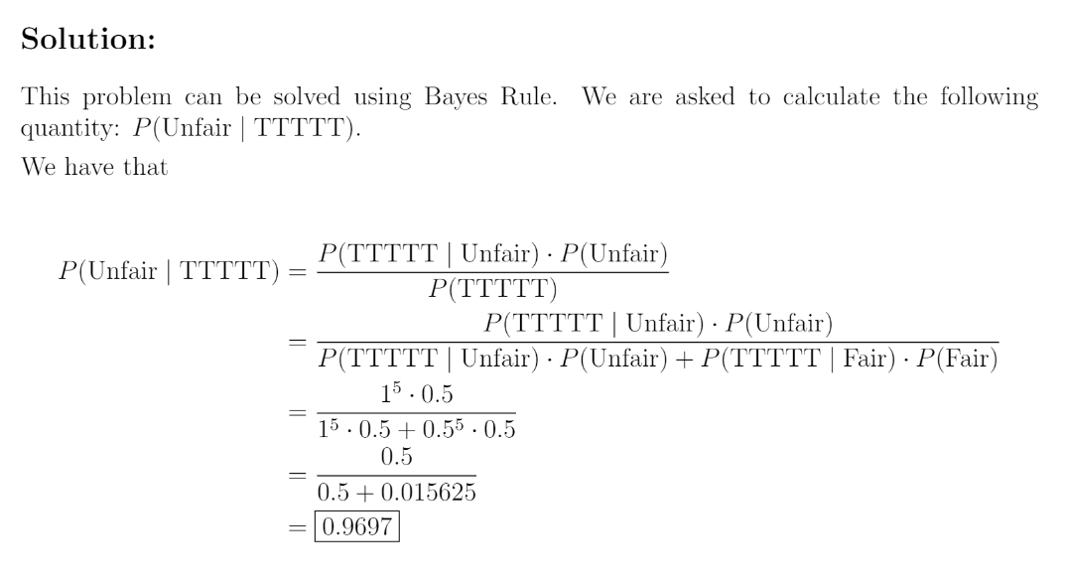
[Facebook - Easy] There is a fair coin (one side heads, one side tails) and an unfair coin (both sides tails). You pick one at random, flip it 5 times, and observe that it comes up as tails all five times. What is the chance that you are flipping the unfair coin?

Slide 29
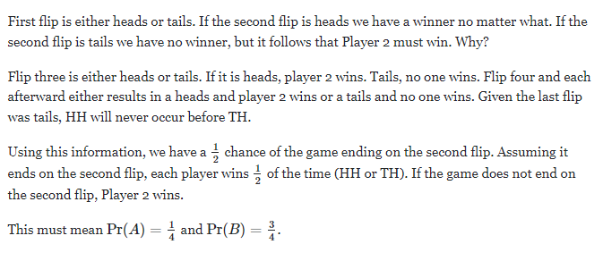
You and your friend are playing a game. The two of you will continue to toss a coin until the sequence HH or TH shows up. If HH shows up first, you win. If TH shows up first, your friend wins. What is the probability of you winning?

Slide 30
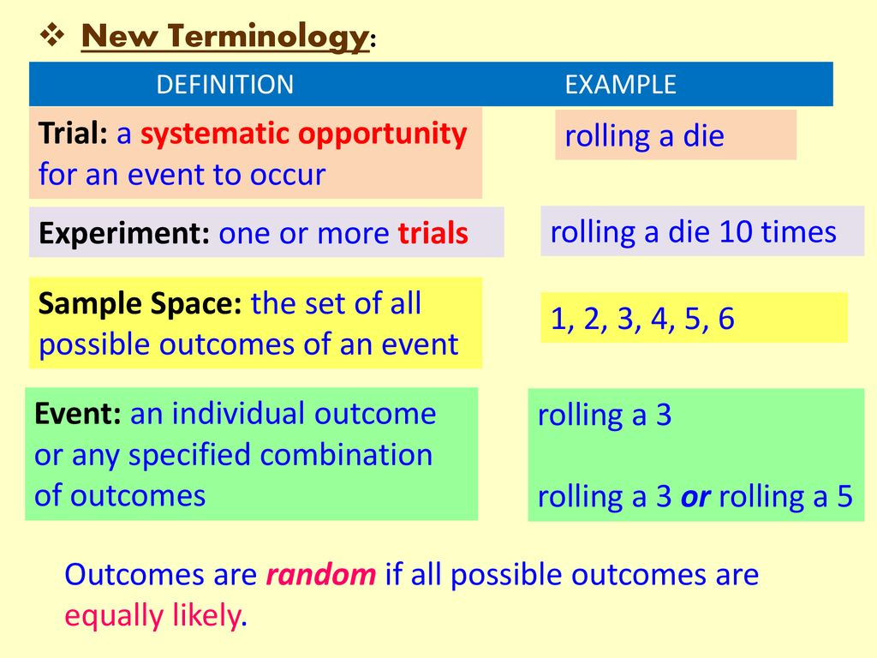

Slide 31
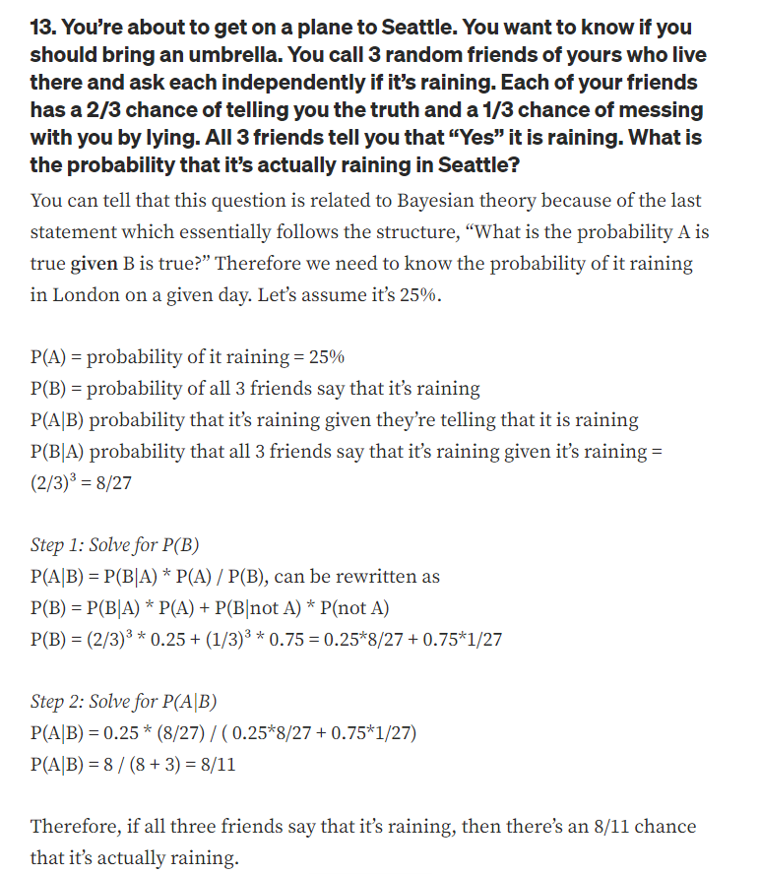

Slide 32
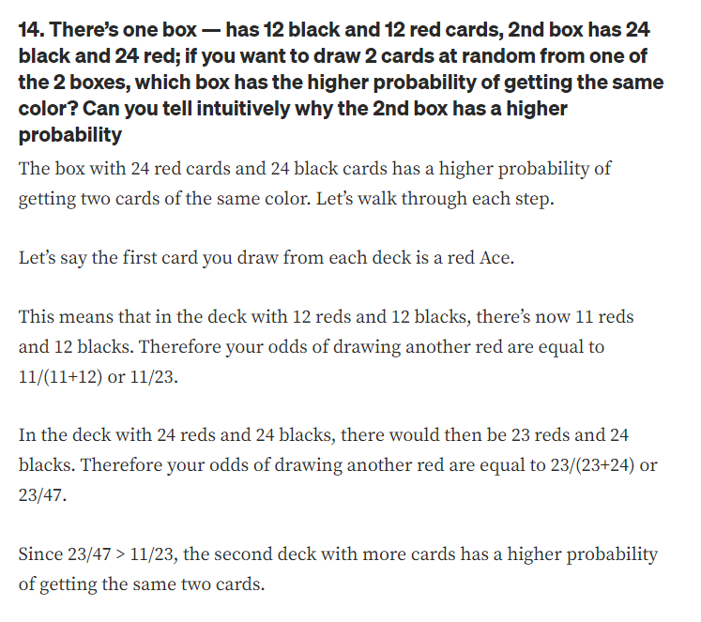

Slide 33
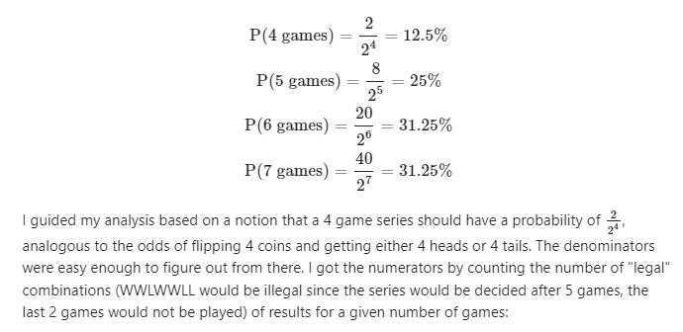
What is the probability that a seven-game series goes to 7 games?
Possible 4 game series (2): WWWW LLLL
Possible 5 game series (8): LWWWW WLLLL WLWWW LWLLL WWLWW LLWLL WWWLW LLLWL
Possible 6 game series (20): LLWWWW WWLLLL LWLWWW WLWLLL LWWLWW WLLWLL LWWWLW WLLLWL WLLWWW LWWLLL WLWLWW LWLWLL WLWWLW LWLLWL WWLLWW LLWWLL WWLWLW LLWLWL WWWLLW LLLWWL
Possible 7 game series (40): LLLWWWW WWWLLLL LLWLWWW WWLWLLL LLWWLWW WWLLWLL LLWWWLW WWLLLWL LWLLWWW WLWWLLL LWLWLWW WLWLWLL LWLWWLW WLWLLWL LWWLLWW WLLWWLL LWWLWLW WLLWLWL LWWWLLW WLLLWWL WLLLWWW LWWWLLL WLLWLWW LWWLWLL WLLWWLW LWWLLWL WLWLLWW LWLWWLL WLWLWLW LWLWLWL WLWWLLW LWLLWWL WWLLLWW LLWWWLL WWLLWLW LLWWLWL WWLWLLW LLWLWWL WWWLLLW LLLWWWL

Slide 34
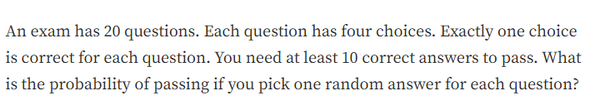
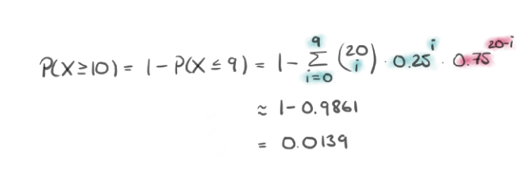

Slide 35
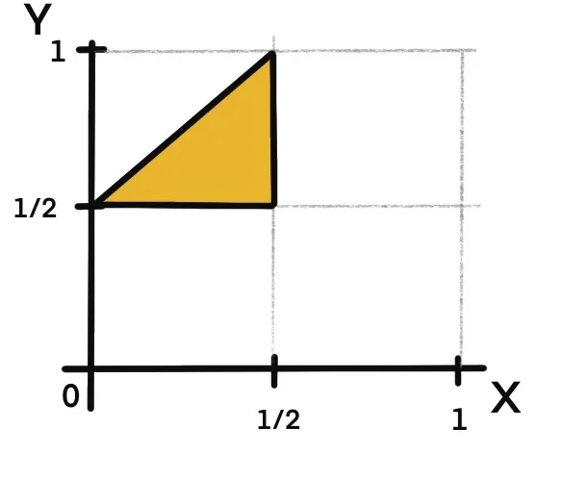
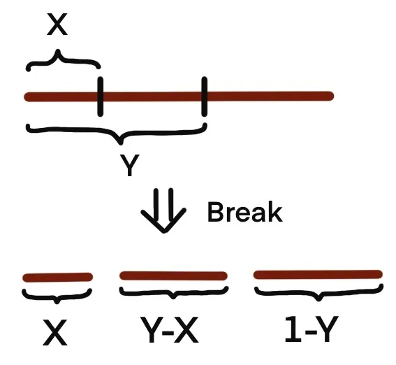
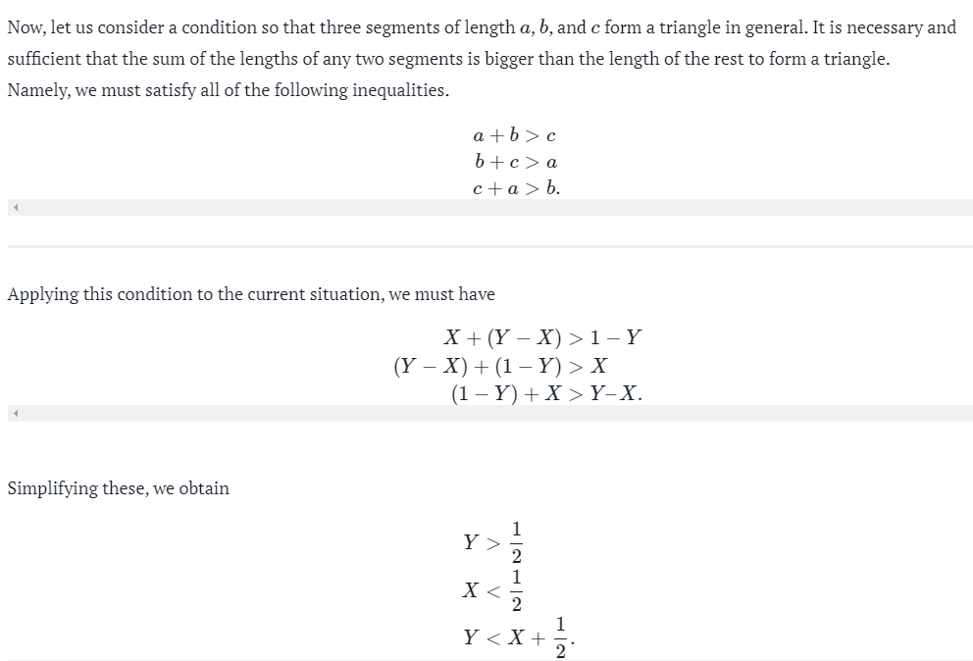
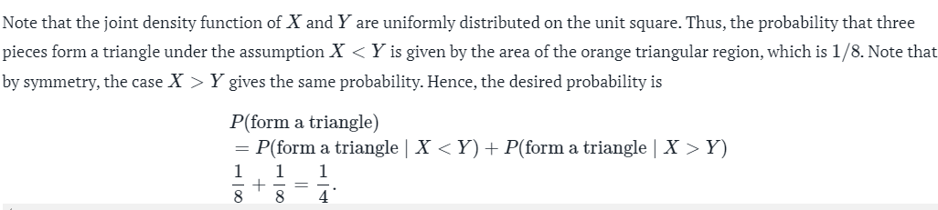
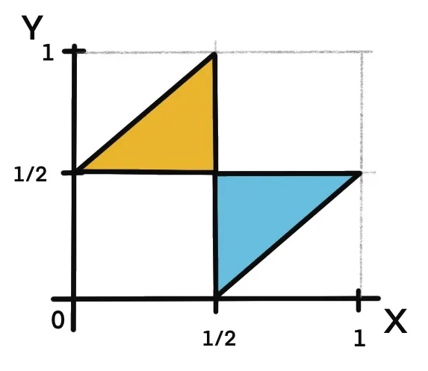

Slide 36
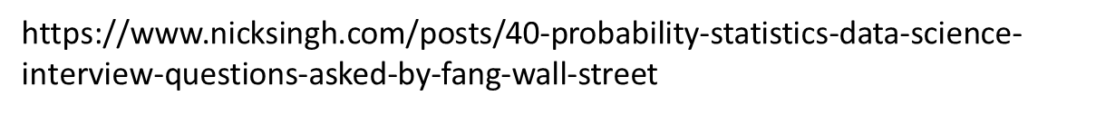
Resources
https://www.kdnuggets.com/2020/01/data-science-interview-study-guide.html
https://cppcodingzen.com/?p=1380
https://github.com/adijo/data-science-prep/blob/master/Daily_Data_Science_Interview_Prep.pdf
https://github.com/youssefHosni/Data-Science-Interview-Questions-Answers/blob/main/Statistics%20Interview%20Questions%20%26%20Answers%20for%20Data%20Scientists.md

